Slide 1


Development Community Meeting
June 30, 2026
Presented by: Development Services

Slide 2
The City of Courtenay recognizes, with respect, the Traditional Territories and unceded lands in which we live, work, and play within. We acknowledge and thank the K’ómoks First Nation and the traditional keepers of the land – who have stewarded the Territory since time immemorial.
In the spirit of reconciliation, the City of Courtenay makes this land acknowledgment to raise awareness of ongoing Indigenous presence and land rights in the territory that includes and encompasses Courtenay. It invites us – a settler government – to reflect on how we might be perpetuating colonial processes that are ongoing and from which we have benefited, as well as the changes we will make to honour the Indigenous peoples and their lands that we inhabit.

Slide 3

Agenda
What we Heard from April 14th Lunch (Zoning Bylaw)
Professional Reliance Model
Transportation Strategic Plan Update
Meet the New Director
Development Industry Lunch
June 30, 2026
courtenay.ca

Slide 4
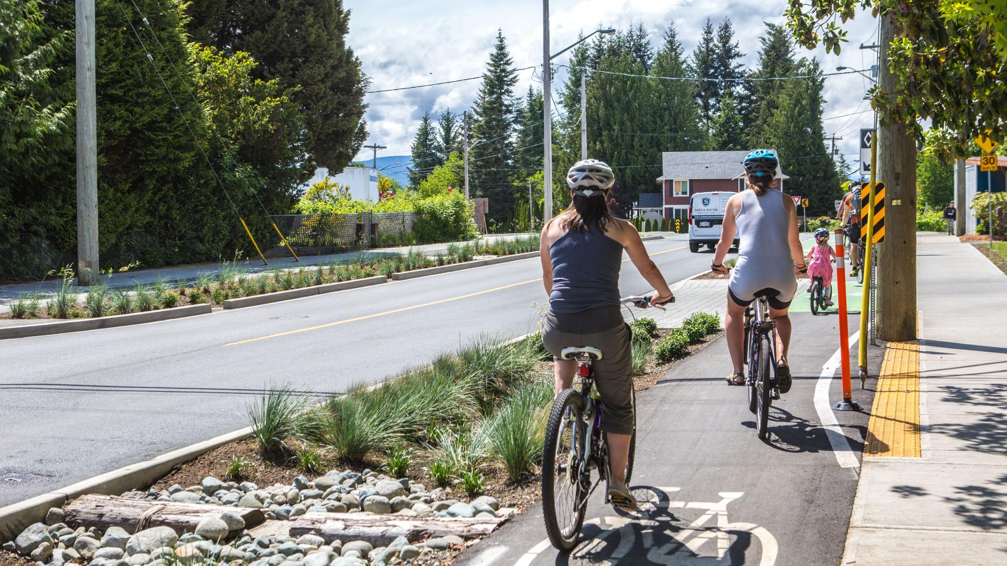
What We Heard
Policy Implementation through Zoning
  Align with OCP growth areas
  As-of-right permissions for forms of development that already support policy (pre-zoning)
Built Form and Physical Site Regulations
  Review standards to reflect urban context
  Prefer units per ha rather than FSR
  Permit landscaped setbacks to serve multiple functions
courtenay.ca
Notes:
Interesting that some of you said you would prefer units per ha rather than FSR – maybe that differs with infill and green field – we will be asking you more about that in the months to come.

Slide 5
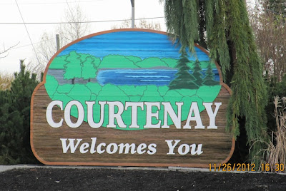
3. Parking, Transportation and Amenity Requirements
  Context-sensitive parking requirements
  Greater flexibility on bike parking
  Flexibility between private and shared amenity spaces
  Use of minimum amenity requirements focused on function rather than fixed ratios
4. Infill and Small-scale Development
  Increase flexibility for small and irregular lots
  Support lot consolidation and shared density across adjacent parcels
  Re-evaluate amenity and parking requirement for infill development
courtenay.ca
Notes:
The April engagement was completed prior to the Phase 1 Zoning Bylaw amendments – bike parking has been modified.

Slide 6
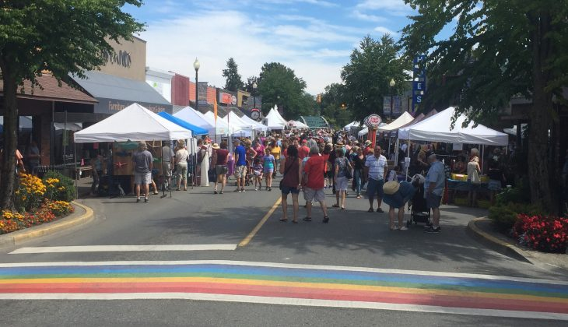
5. Base Zoning and Regulatory Flexibility
  Incorporate flexibility rather than negotiating project by project
  Allow more permitted uses
  Consider pre zoning priority development areas (big incentive)
6. Zoning Bylaw Structure, Clarity and Usability
  Clearer more complete definitions
  Consistent layout and numbering
  Use of intent/purpose statements to clarify expectations
  Better and more diagrams
  Hyperlinks
courtenay.ca

Slide 7
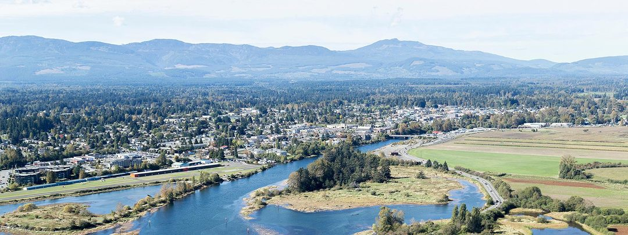
7. Certainty and Consistency
  Alignment between zoning, development guidelines, and other bylaws
  Consistent application of rules to avoid case‑by‑case uncertainty
8. Incentives and Development Feasibility
  Use of density bonuses to improve project feasibility
  Allow for reduced parking requirements with tenant incentives
  More incentives to support the delivery of long‑term rental housing and larger units
  Tax or fee incentives, such as exemptions
courtenay.ca
Notes:
Density bonusing is an interesting topic – tell us how we can bonus – we want below market housing units 2 and 3 bedroom
How do we incentivize reduced parking with tenant benefits – No one can figure out how to make it happen and if the transit in courtenay is even wok bonusing

Slide 8
Timeline for Zoning Bylaw Phase 2
Phase 1 Complete
May 2026
Draft Zoning Bylaw
November 2026
First Reading March 2027
Stantec Recommendation Report
June 2026
Staff Review and Provide Direction
August 2026
Prepare Status Report for Council
September 2026
Edits and Revisions
February 2027
Engagement
November, December 2026 and January 2027

Slide 9
Professional Reliance Model
In an effort to speed up the process, the City has shifted to a Professional Reliance Model.
This means that we will not be providing the advice and direction to your professional consultants.
It also means that if the consultant does not perform work that meets standards, there could be requirement to re-do the work.
courtenay.ca

Slide 10
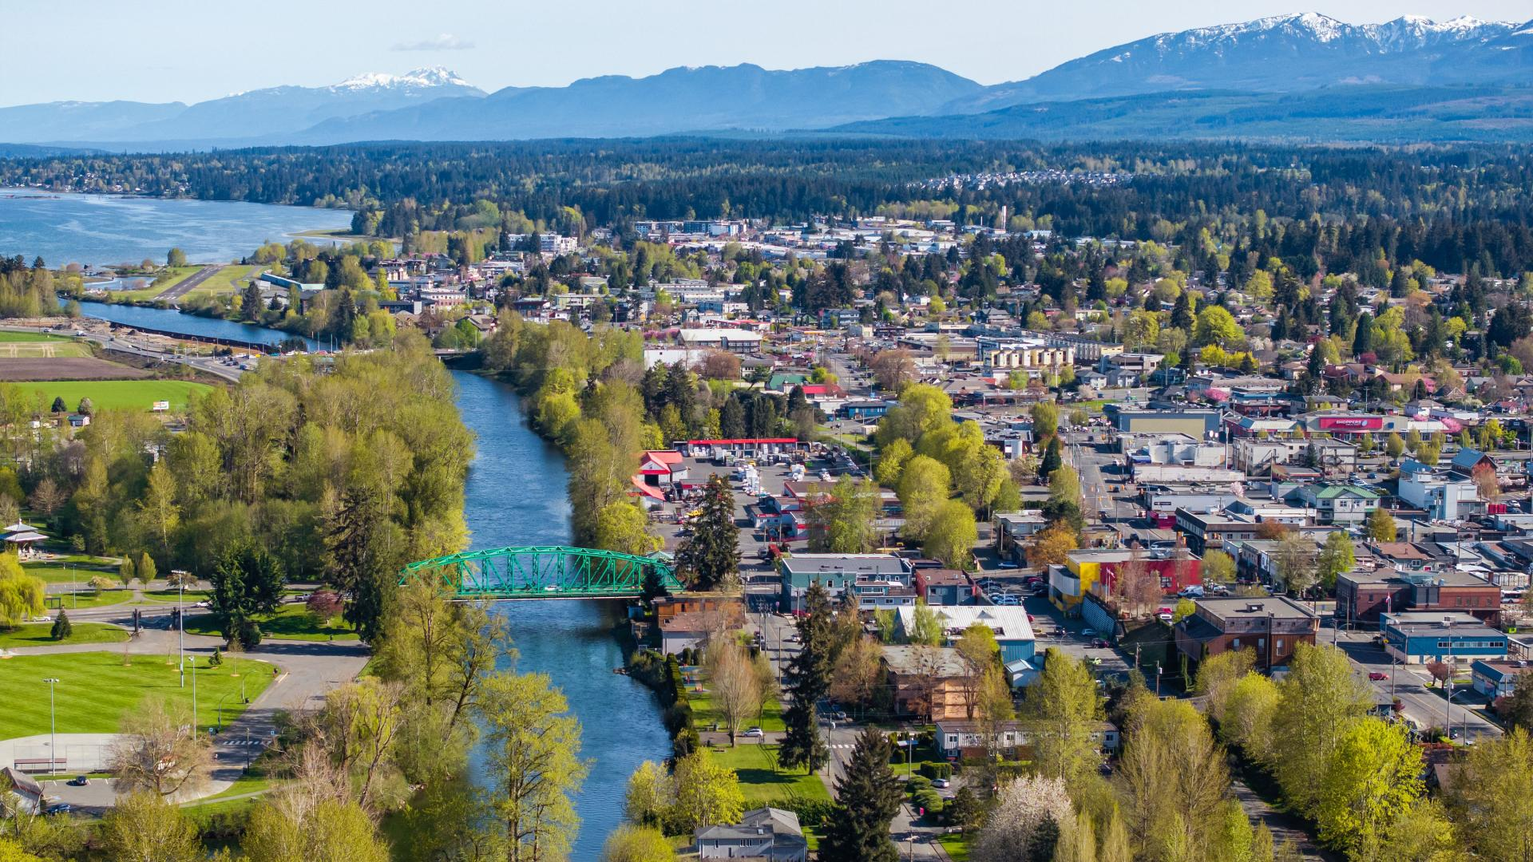
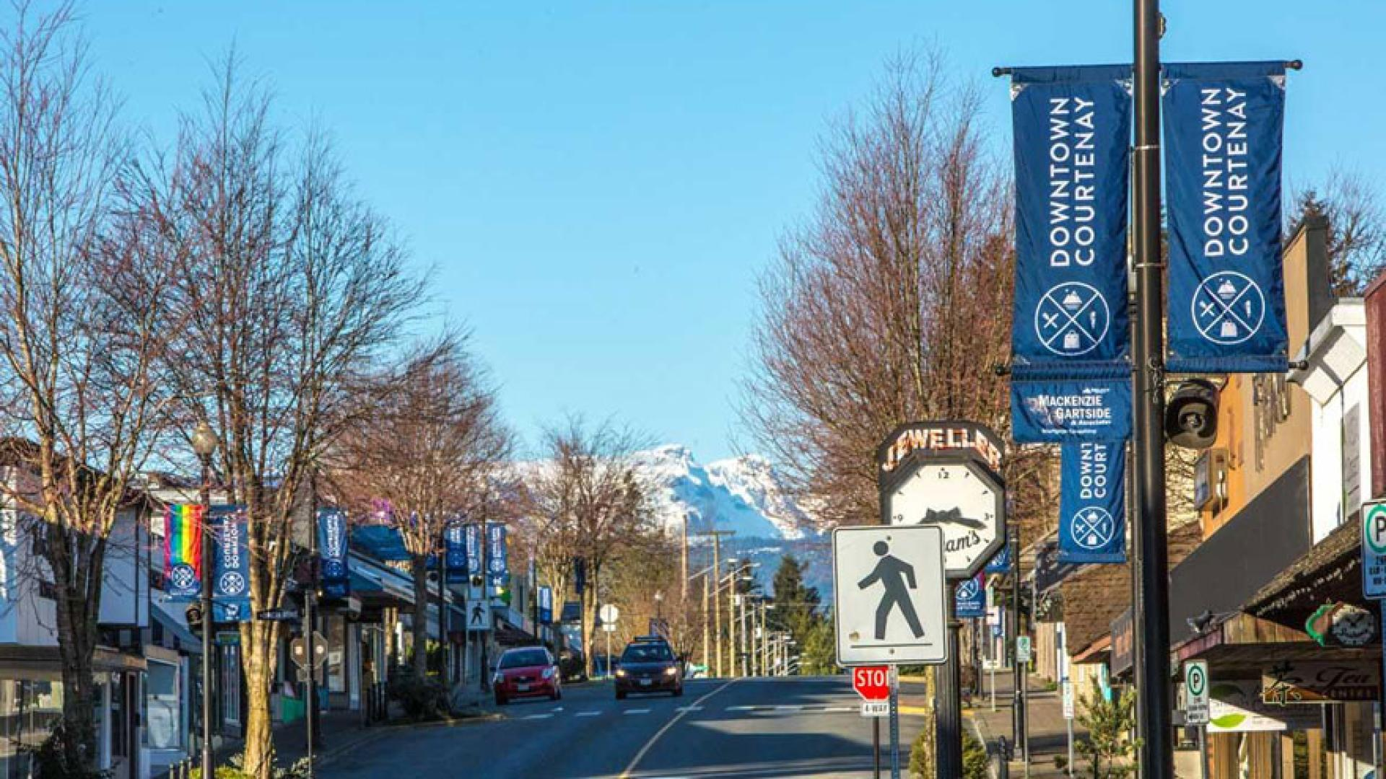
Professional Reliance Model
  Version
  Version 6 has been reviewed by EGBC legal counsel
  Version 7 is being submitted to EGBC for final endorsement by EGBC
  Industry Feedback
  Need an updated guide
  Need an updated approved products list
  Need to re-establish annual updates to approved product list
  Do we need Assurance forms for shallows?
    coordinate professional or civil responsible to review shallows
  Do we need Assurance forms for Environmental Monitoring?
    not through this process but we do require individual assurances
courtenay.ca

Slide 11
Development Servicing Variances
      variances are to be requested and approved or rejected prior to pre-construction meeting
      variances to standards during design process may still take 2 months for response from City
      variances are tracked internally and any acceptable changes to standards will be issued a design brief
courtenay.ca

Slide 12
Construction Management
      Design/contract changes are purview of Professional of Record
      City only involved if variance to bylaws, standards or works agreement
      City strongly suggests preliminary investigations are completed prior to contract
      City likely unable to attend construction site for weeks to consider unexpected conditions/variances (Geotech/utility locates)
      Substantial Completion and Final Site Inspections will be only time City staff review design/construction
      Variances to Standards/Bylaws will not be accepted when identified at Substantial/Final Inspection, similar to BCBC requirements
      Minimum inspections, please refer to the:
      EGBC Guide to the Standard for Documented Field Reviews
      During Implementation or Construction
      In addition, as the City is the end owner and user of the infrastructure, we require weekly submissions of inspections
courtenay.ca

Slide 13
Check List
Prefer each Professional provide their initialed section to coordinating profession who combines into 1 check list
Prefer initials rather than check marks to protect professionals
courtenay.ca

Slide 14
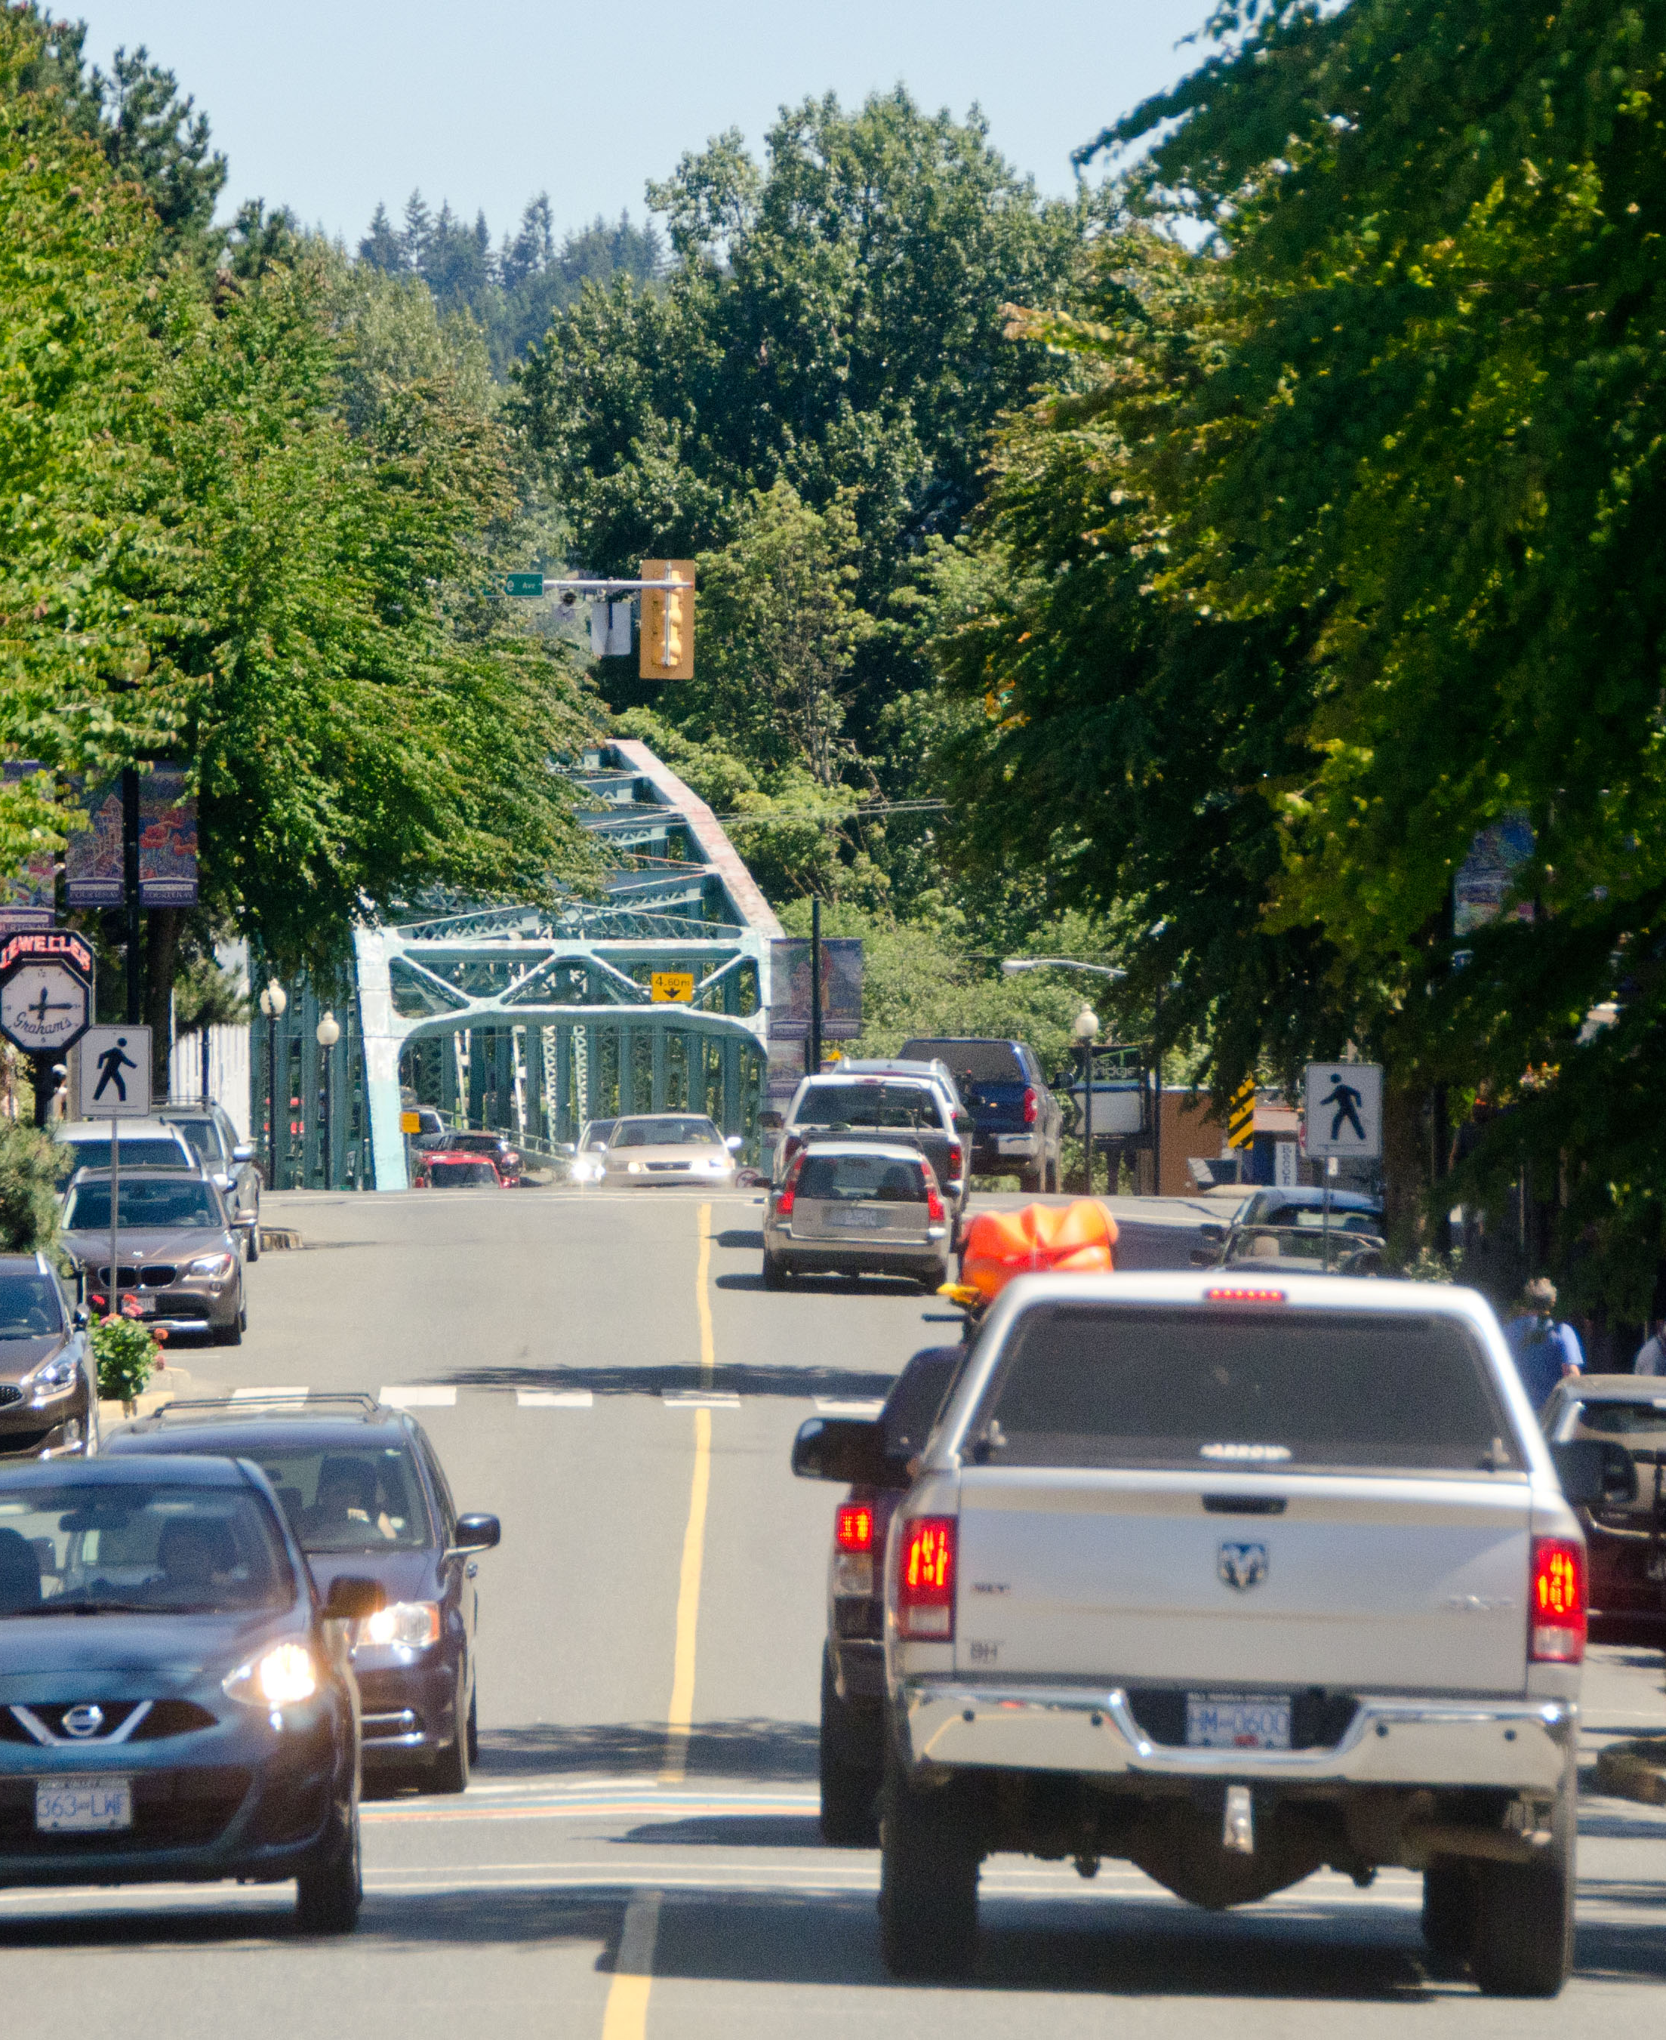

Development Community Meeting
June 30 2026

Slide 15
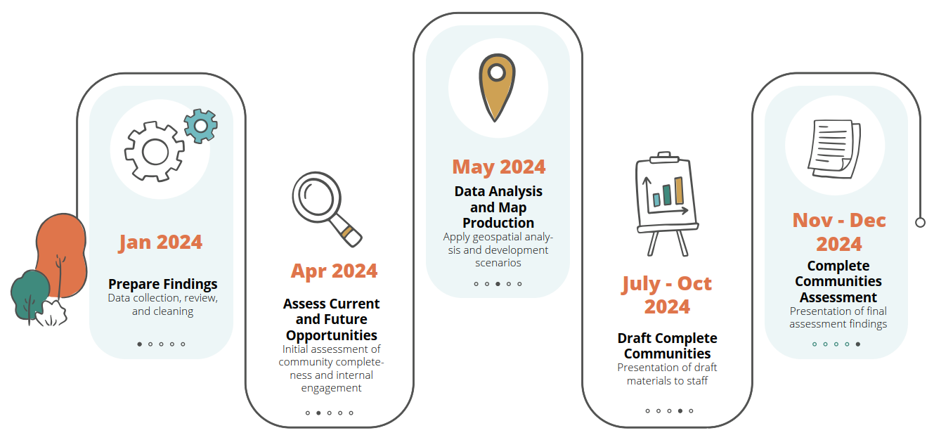
Process
We are here!
Dec 2025- Mar 2026
Visioning
Community engagement
Sept 2025- Oct 2025
Preparing
Launch, planning, communications
Aug 2026- Feb 2027
Moving Forward
Implementation, approvals
Oct 2025- Dec 2025
Discovering
Research, study, inventory
Mar 2026- Aug 2026
Planning
Plans, actions, engagement

Slide 16
Community Engagement, Phase 1
Engagement at a Glance
INTEREST HOLDER CONVERSATIONS
PEOPLE AT THE
OPEN HOUSE
13
388
65
CONTRIBUTIONS ON
THE INTERACTIVE MAP
316
5,300
SURVEY RESPONSES
WEBSITE VISITS

Slide 17
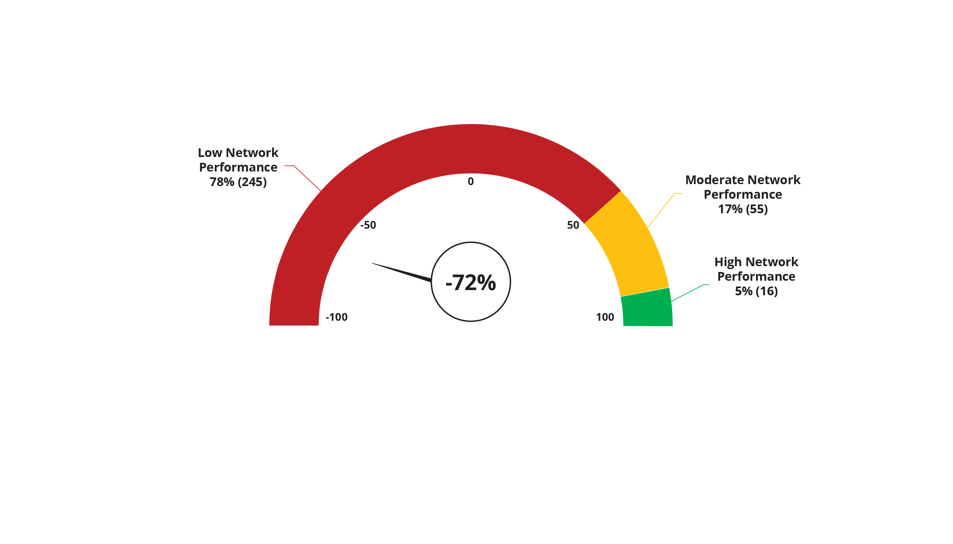
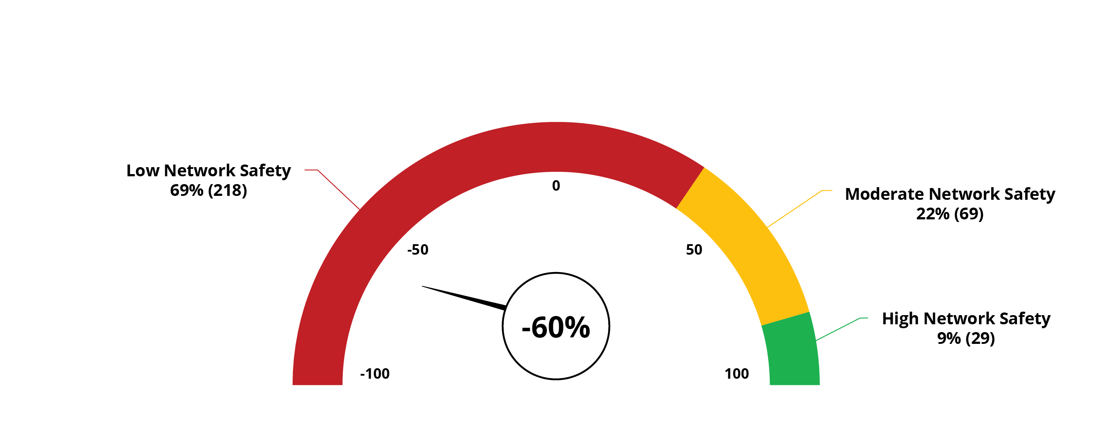
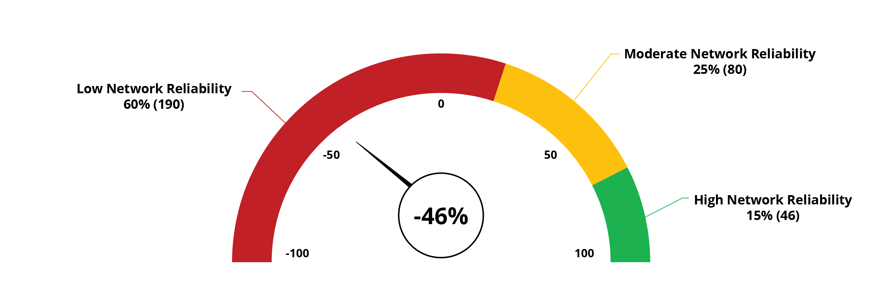
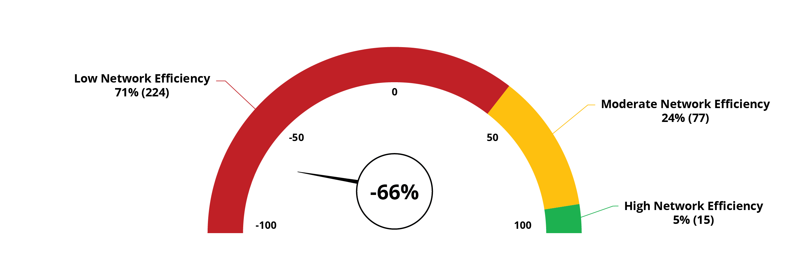
KPIs – Network-Wide
Community Engagement, Phase 1
5.54
5.03
4.83
4.61
Reliability
Safety
Efficiency
Satisfaction

Slide 18
KPIs by Mode
Community Engagement, Phase 1
Survey respondents ranked each mode based on the four KPIs
Mode | Satisfaction | Reliability | Efficiency | Safety
Walking | 2.91 | 2.89 | 2.6 | 2.46
Cycling | 2.23 | 2.39 | 2.63 | 1.52
Transit | 1.78 | 1.51 | 1.6 | 2.78
Driving | 3.08 | 3.21 | 3.17 | 3.25

Slide 19
KPIs by Mode
Community Engagement, Phase 1
Mode | Satisfaction | Reliability | Efficiency | Safety
Walking | 2.91 | 2.89 | 2.6 | 2.46
Cycling | 2.23 | 2.39 | 2.63 | 1.52
Transit | 1.78 | 1.51 | 1.6 | 2.78
Driving | 3.08 | 3.21 | 3.17 | 3.25
Transit was ranked lowest in 3 of 4 KPIs

Slide 20
KPIs by Mode
Community Engagement, Phase 1
Mode | Satisfaction | Reliability | Efficiency | Safety
Walking | 2.91 | 2.89 | 2.6 | 2.46
Cycling | 2.23 | 2.39 | 2.63 | 1.52
Transit | 1.78 | 1.51 | 1.6 | 2.78
Driving | 3.08 | 3.21 | 3.17 | 3.25
Cycling was ranked lowest in safety

Slide 21
KPIs by Mode
Community Engagement, Phase 1
Mode | Satisfaction | Reliability | Efficiency | Safety
Walking | 2.91 | 2.89 | 2.6 | 2.46
Cycling | 2.23 | 2.39 | 2.63 | 1.52
Transit | 1.78 | 1.51 | 1.6 | 2.78
Driving | 3.08 | 3.21 | 3.17 | 3.25
Driving was ranked highest in each KPI

Slide 22
Community Engagement, Phase 1
Transportation System Priorities
Survey respondents indicated that transit, walking, and cycling should be considered high priority.

Slide 23
Looking Forward
Key Themes / Areas of Focus
Defining a Major Road Network (MRN)
Improved public transit service
Enhanced road safety
Advance active transportation network upgrades
Address congestion / reduce travel time

Slide 24
Looking Forward
STP Objectives (draft)
Road Safety Fewer crashes on Courtenay streets
Efficiency / Mobility Reduced travel time on key corridors
Sustainable Transportation Greater proportion of trips using sustainable modes

Slide 25
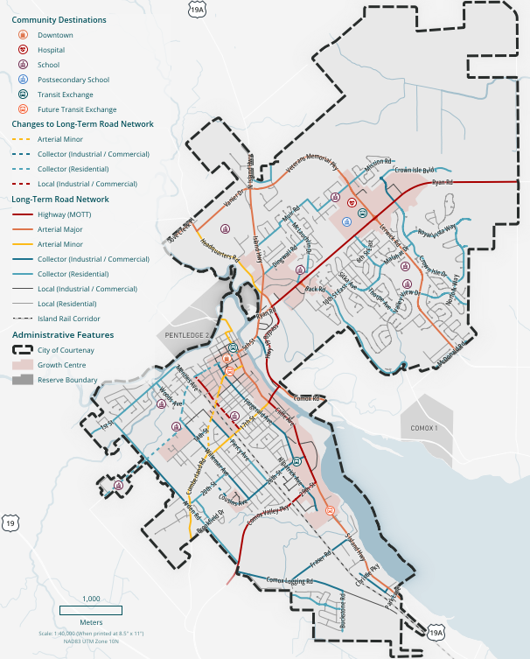
Looking Forward
Modelling / Street Network
Corridor Travel Time
Corridor Modelling (demand model)
Intersection Analysis

Slide 26
Looking Forward
Items for the Development Community
New street connections
Contributions to intersection + corridor upgrades
Transit supportive land use
Updated street cross-sections
Modernized off-street parking requirements
Notes:
Discussion on contributions to intersections and corridor upgrades will be tied to DCC’s and off site upgrades

Slide 27

Thank you!

Slide 28
Meet the New Director
Jake Belobaba
courtenay.ca

Slide 29
Thank you for coming!
Taking the Summer off….
Next Development Community – City meetings:
Following the Municipal Election October 17th, 2026
As part of Zoning Bylaw engagement in November/December 2026
Optional footer: Event name
Date
courtenay.ca
Notes:
We will be creating a follow up survey from the April Zoning Bylaw discussion to delve into some of the topics a bit more – like the density bonusing

